Slide 1
Quiz app by
BHUSHAN AMIT
GANDHI

Slide 2
AGENDA
Introduction​
Primary goals
​Libraries
Features
​Conclusion

Slide 3
Introduction
Purpose: This Python script is a simple quiz application using the Tkinter library for the graphical user interface (GUI) and SQLite for database management.
The app allows users to log in, answer a set of pre-defined questions, and then provide a score.

Slide 4
PRIMARY GOALS

Slide 5
In this Python script using Tkinter and SQLite, a quiz application is developed with a login interface, dynamic question loading, and interactive quiz elements, guiding users through a set of predefined questions, tracking their scores, and storing the results in a database upon completion
“
”

Slide 6


GUI DESIGN:
Quiz functionality
The graphical user interface (GUI) is implemented using the Tkinter library for a desktop quiz application.
The GUI includes elements such as labels, buttons, entry widgets, and radio buttons, providing a user-friendly interface.
The code defines a QuizApp class that handles the quiz functionality, including loading questions from the database, presenting questions, and tracking the user's score.
Questions are fetched from the database and presented to the user, who can select an answer using radio buttons. The code ensures that an option is selected before moving to the next question

Slide 7
Quiz completion & Submission:
Start quiz & login feature:
Once the user completes the quiz, the code displays the final score and inserts the student's information and score into the student_data table in the database.
A message box notifies the user when the quiz is completed, and the user can submit their quiz
The code includes a "Start Quiz" button that triggers the beginning of the quiz after the user enters their name and PRN.
A login screen with a background image is presented at the start, creating a visually appealing and engaging entry point for the quiz.

Slide 8
functionality
Database Setup
quizApp class
Quiz logic
NO LIMIT ON QUESTIONS.
Application initialization
Additional notes
date & time strap.

Slide 9
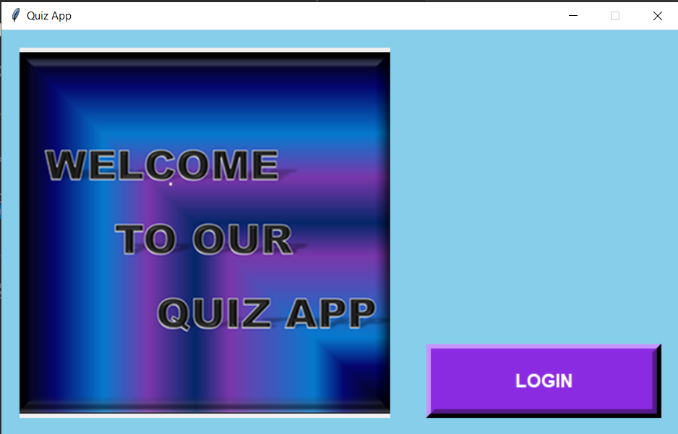
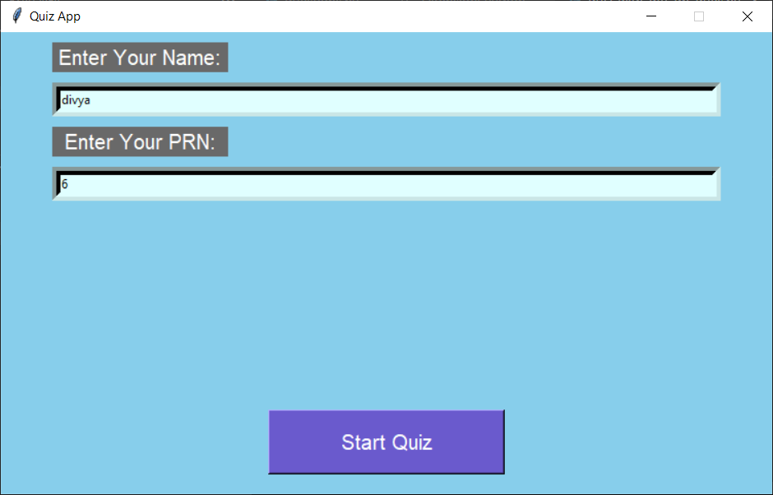
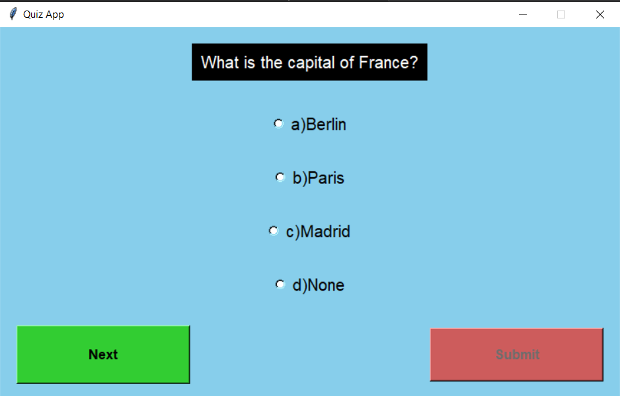
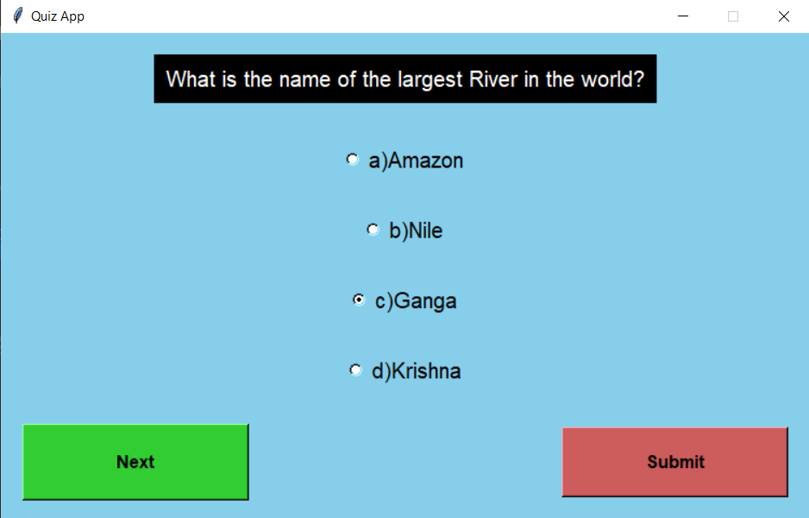
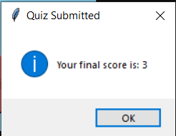
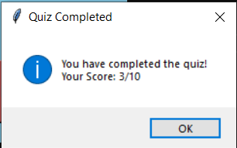
View of quizz app

Slide 10
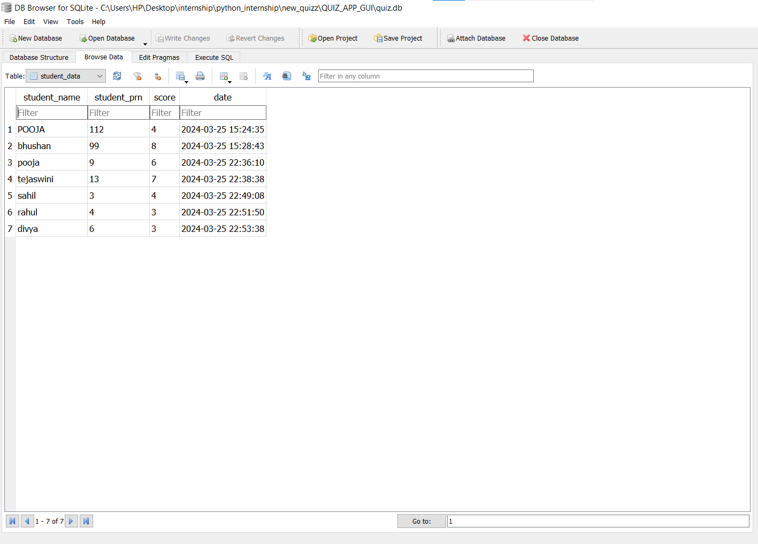
DATABASE VIEW AFTER QUIZ SUBMIT

Slide 11
conclusion
The presented code provides a foundation for a basic quiz application with the potential for expansion and customization…

Slide 12
THANK YOU

